Slide 1
Signals and Systems
March 25, 2013

Slide 2
Summary thus far: software engineering
Focused on abstraction and modularity in software engineering.
Topics: procedures, data structures, objects, state machines
Lab Exercises: implementing robot controllers as state machines
SensorInput Action
Abstraction and Modularity: Combinators
Cascade: make new SM by cascading two SM's
Parallel: make new SM by running two SM's in parallel
Feedback: make new SM by connecting an output to one of the inputs
Themes: PCAP
Primitives – Combination – Abstraction – Patterns
Brain

Slide 3
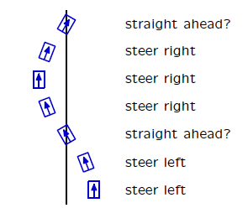
Next: signals and systems
Focus next on analysis of feedback and control systems.
Topics: difference equations, system functions, controllers.
Lab exercises: robotic steering

Slide 4
Understanding systems
Good news: We can build interestingly complex state machines to control our robots.
Bad news:
We can't predict how well our controllers are going to work, except by running them, possibly several times, and gathering data.
When they don't work well, we don't have any systematic way of changing them to make them work better.
Solution:
Make models of the controller and of the robot and its world.
Analyze the models mathematically to characterize performance and understand how to improve it.

Slide 5

State machines as models
Make a state machine model of the plant: that is, the aspects of the external world that you are trying to control
Make a state machine model of your controller
Connect the state machines (cascade and feedback)
Run it to see what happens

Slide 6
Computer programs are unpredictable
Could we figure out what will happen without running the simulation, just by looking at the definitions of the controller and the plant?
In general, no.
It is impossible to predict even whether a general computer program will terminate and produce a result.

Slide 7
LTI systems are predictable
Consider simpler class of state machines:
State: last j inputs to the system, plus last k outputs of the system
Output: a fixed linear function of the input and the state
Linear time-invariant (LTI) systems:
Can be analyzed mathematically, to predict behavior without simulation
Are compositional: cascade, parallel, and feedback compositions of LTI systems yield LTI systems

Slide 8
SM and LTI
Programs
SM
LTI

Slide 9
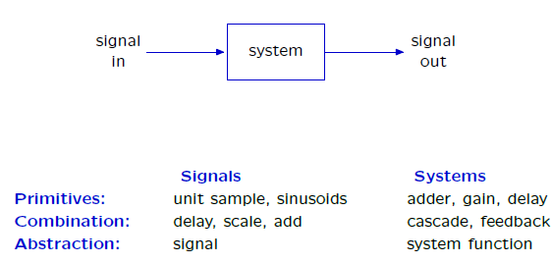
The signals and systems abstraction
Describe a system by the way it transforms inputs into outputs.

Slide 10
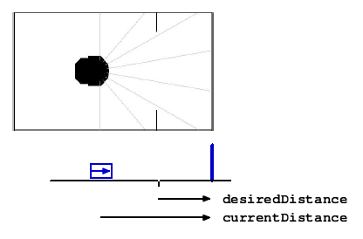
Analyzing (and predicting) behavior
Example: use sonar sensors (i.e., currentDistance) to move robot desiredDistance from wall.

Slide 11
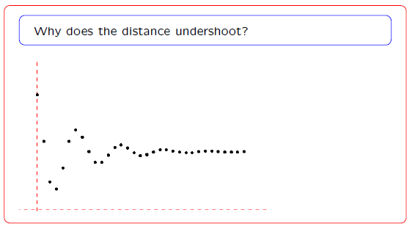
Check yourself

Slide 12

Performance analysis
Quantify performance by characterizing input and output signals.

Slide 13

The signals and systems abstraction
Describe a system (physical, mathematical, or computational) by the way it transforms an input signal into an output signal.

Slide 14
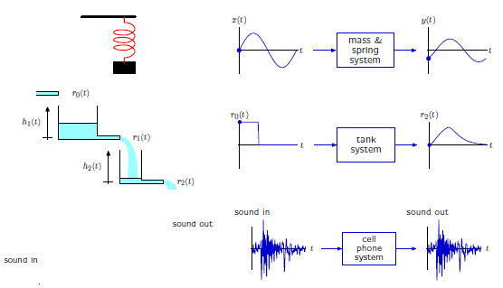
Signals and systems: widely applicable
Signals and systems abstraction has broad application: electrical, mechanical, optical, acoustic, biological, financial, ...

Slide 15
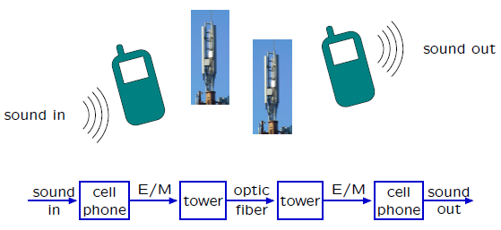
Signals and systems: modular
The representation does not depend upon the physical substrate.
focuses on the flow of information, abstracts away everything else

Slide 16
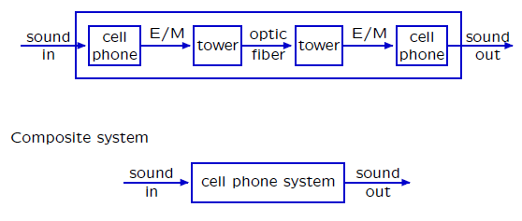
Signals and systems: hierarchical
Representations of component systems are easily combined.
Example: cascade of component systems
Component and composite systems have the same form, and are analyzed with same methods.

Slide 17

The signals and systems abstraction
Our goal is to develop representations for systems that facilitate analysis.
Examples:
Does the output signal overshoot? If so, how much?
How long does it take for the output signal to reach its final value?

Slide 18
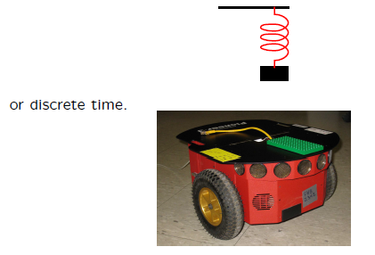
Continuous and discrete time
Inputs and outputs of systems can be functions of continuous time
We will focus on discrete-time systems.

Slide 19
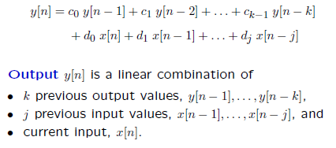
Linear time-invariant systems
linear: dependence of output on inputs is linear
time-invariant: the same relationship between inputs and outputs holds for any value of n
causal: sample at time n only depends on values at the same or previous time steps
Any LTI system can be described using a difference equation:

Slide 20

Feed-forward systems
Difference equation denes the output of a system at a particular time in terms of its previous inputs

Slide 21
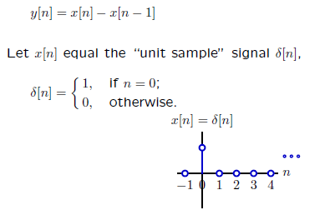
Difference Equations
Difference equations are mathematically precise and compact.
Example:
We will use the unit sample as a “ primitive“ (building-block signal) to construct more complex signals.

Slide 22
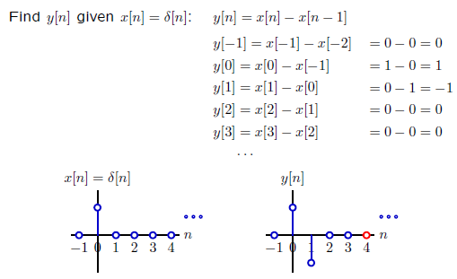
Step-by-step solutions
Difference equations are convenient for step-by-step analysis.

Slide 23
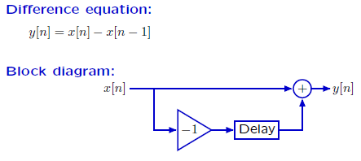
Block diagrams
Block diagrams are useful alternative representations that highlight visual/graphical patterns.
Same input-output behavior, different strengths/weaknesses:
difference equations are mathematically compact
block diagrams illustrate signal flow paths

Slide 24

From Samples to Signals
Operators manipulate signals rather than individual samples.
Nodes represent whole signals (e.g., X and Y ).
The boxes operate on those signals:
Signals are the primitives.
Operators are the means of combination.

Slide 25
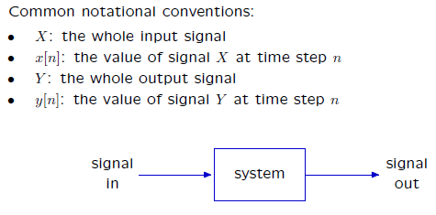
Signals
A signal is an infinite sequence of sample values at discrete time steps.
Systems transduce input signals into output signals.

Slide 26
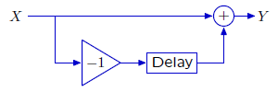
Operations on signals
Operators manipulate signals rather than individual samples.
Wires represent whole signals (e.g., X and Y ).
The boxes operate on those signals

Slide 27
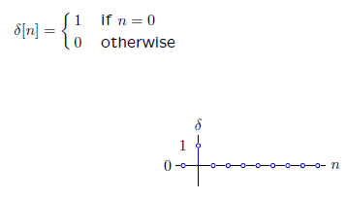
Unit sample signal
Only crucial primitive in our PCAP system:
Other useful primitives are step and sinusoid signals. Discussed in readings and exercises.

Slide 28
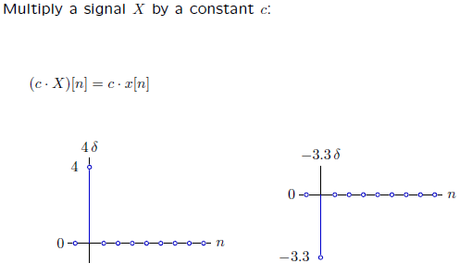
Operations on signals: scaling
Constant c often called a gain.

Slide 29
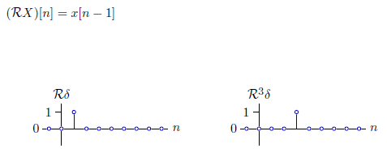
Operations on signals: delay
Shift signal X to the right (later in time), getting RX:

Slide 30
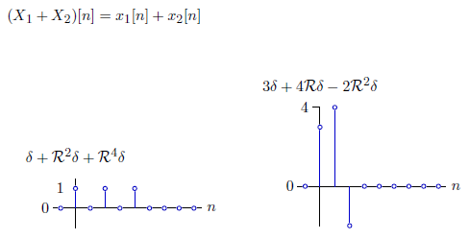
Operations on signals: addition
Add signals X1 and X2 together to get a new signal X1 + X2:

Slide 31
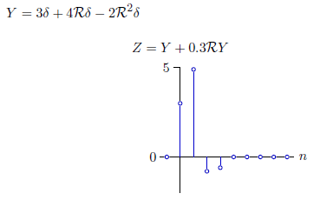
Abstracting signals
Scaling, delay, addition all return new signals that can be further combined
Abstract by naming
Any signal with finitely many non-zero samples can be constructed from δ with delay, adder, and gain operations.

Slide 32
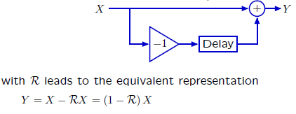
Operator notation
Symbols can now compactly represent diagrams.
Representing the difference machine

Slide 33
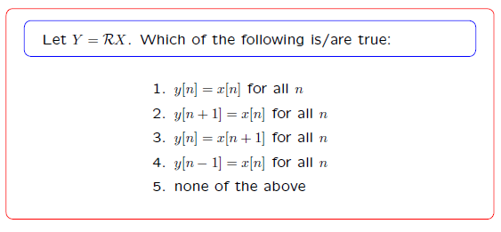
Cohort Exercise 1

Slide 34
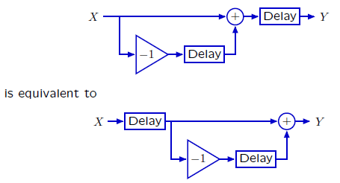
Operator algebra: commutativity
Expressions involving R obey many familiar laws of algebra, e.g., commutativity.
R(1 - R)X = (1 - R)RX
This is easily proved by the definition of R, and it implies that cascaded systems commute (assuming initial rest)

Slide 35
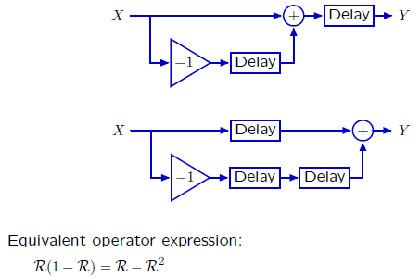
Operator algebra: distributivity
Multiplication distributes over addition.
Equivalent systems

Slide 36
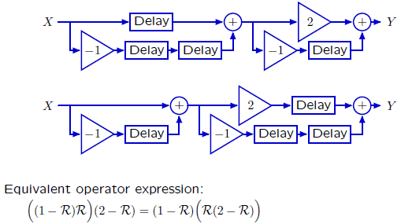
Operator algebra: associativity
The associative property similarly holds for operator expressions.
Equivalent systems

Slide 37
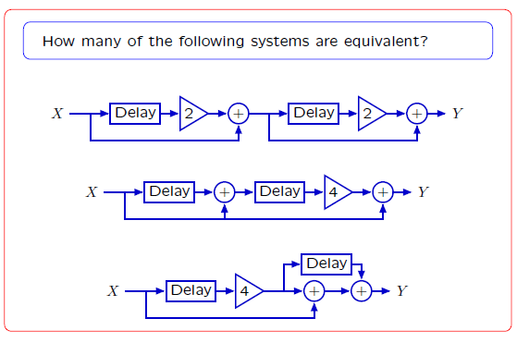
Cohort Exercise 2

Slide 38


Feedforward and feedback systems
Feedforward: output depends only on previous inputs
Recipe: output signal equals difference between input signal and right-shifted input signal.
Feedback: output depends on previous inputs and outputs
Constraints: find the signal Y such that the difference between Y and RY is X. But how?

Slide 39
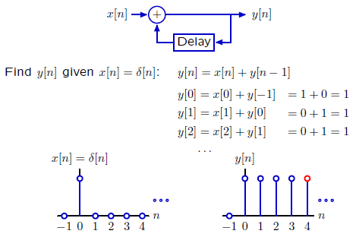
Example: Accumulator
Try step-by-step analysis: it always works. Start "at rest.“
Persistent response to a transient input!

Slide 40
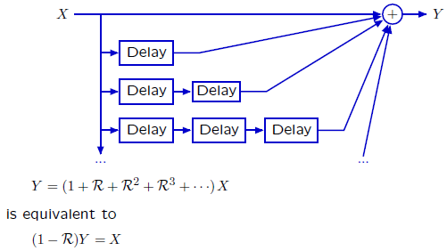
Example: Accumulator
The response of the accumulator system could also be generated by a system with infinitely many paths from input to output, each with one unit of delay more than the previous.
Proof in readings

Slide 41
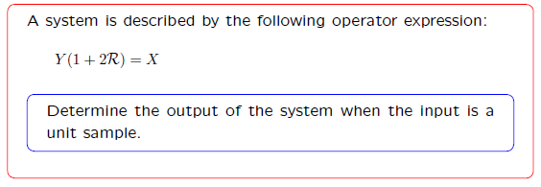
Check Yourself

Slide 42
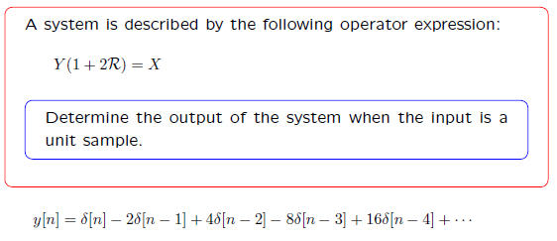
Check Yourself

Slide 43
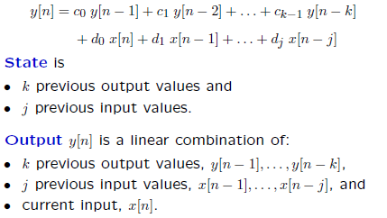
Linear time-invariant systems
Any LTI system can be described using a difference equation of the form:

Slide 44
Cohort Exercise 3

Slide 45


Linear time-invariant systems
Any LTI system can be described using a difference equation of the form:
Any LTI system can be described using an operator equation of the form:

Slide 46
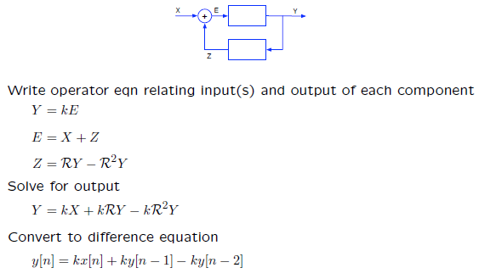
Combining modules
Assign names to all wires

Slide 47
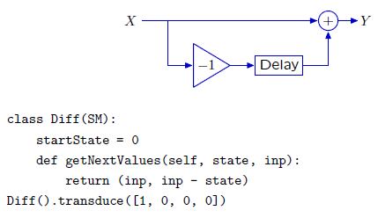
LTI systems as state machines

Slide 48
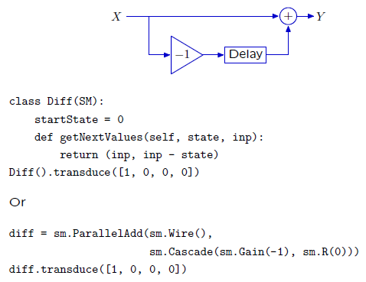
LTI systems as state machines

Slide 49
Cohort Exercise 4

Slide 50
Multiple representations of LTI systems
difference equations: good for step-by-step simulation
block diagrams: good for signal-flow intuition
operator expressions: good for compact description and combining systems
Python SM subclasses: implementation of difference equation
Python combination of primitive SMs: implementation of difference equation, but easier to get right

Slide 51
This Week
Readings: Chapter 5.1-5.4 of Digital World Notes (mandatory!)
Cohort Exercises & Homework: Practice on LTI systems (note the due dates & times)
Cohort Session 2 & 3: Constructing and using LTI model for robot control

